Slide 1
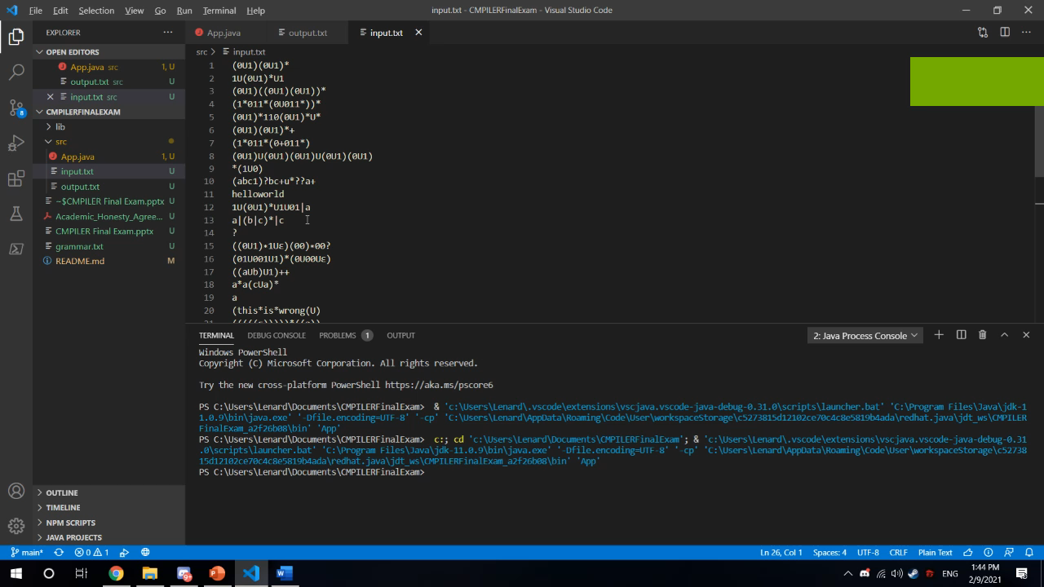
Lenard Balwin To CMPILER S11

Slide 2
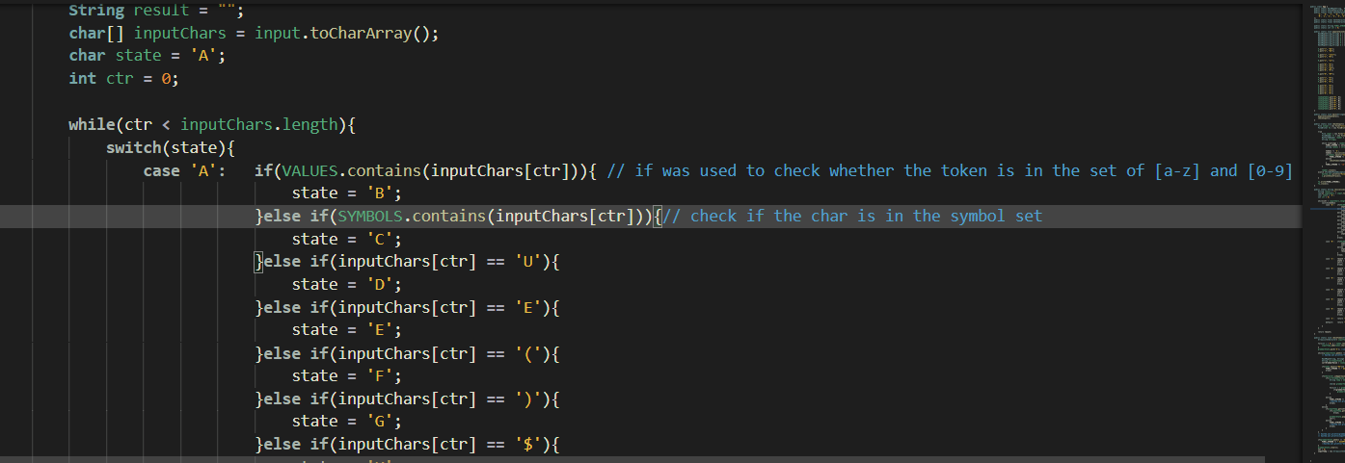
Lexical Analyzer
The lexical analyzer was utilized to convert regex input into understandable terminal symbols for the syntax analyzer. In this code DFA was used in order to check and convert the input to the syntax analyzer. In this code depending on the token of the input the first state will check if the token is in the symbol set or the alphanumerical set and then check the other needed terminals. Afterwards it will continue to change the state of the DFA. Thereafter the input will then be converted into terminal nodes.

Slide 3
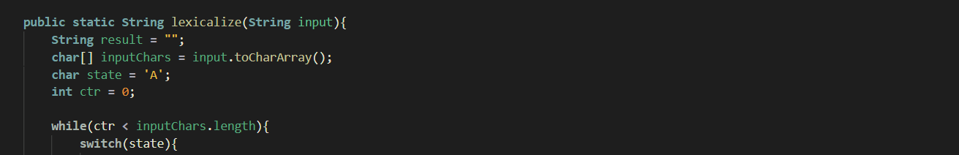
Lexical Analyzer
Tokenizing was done by splitting the acquired line into individual tokens or characters in which was iterated and check thoroughly by the lexical analyzer. As well as individual characters are organized into understandable terminal tokens such as “aaabbababa” into “character terminal”, “*” into “symbol terminal”.

Slide 4
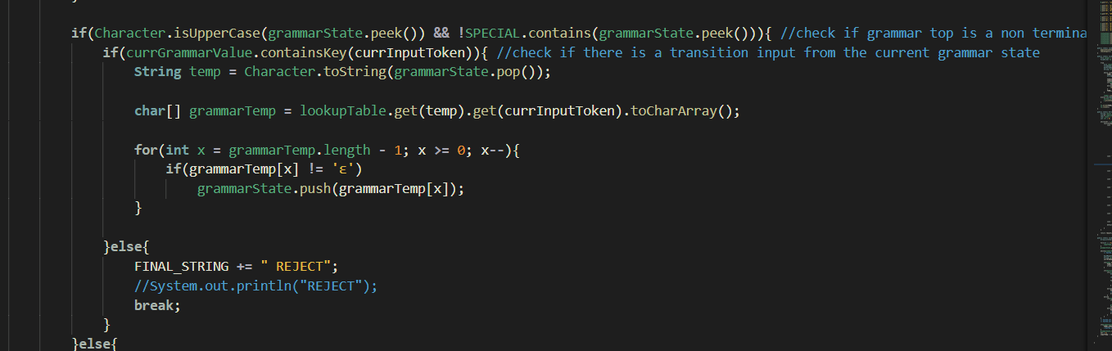
Syntax Analyzer
The syntax analyzer was built from a LL(1) parser through using the First and Follow sets and the look up table First we populate the look up table then we check if the grammar top is a terminal node then we check if there exist a transition from the lookup table that acquires the lexicalized input tokens. If there’s no transition the analyzer will return a reject if there is, the analyzer will proceed to expand the grammar, then eventually will compare the terminal symbols if it reaches a terminal grammar top then pop and repeat the process.

Slide 5
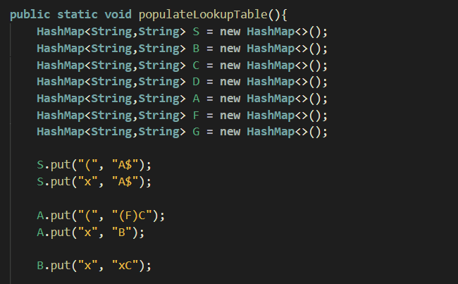
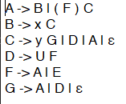
Syntax Analyzer
This is the grammar used for the lookup table In which was converted into a lookup table through utilizing first and follow sets. The lookup table was then populated through a HashMap of HashMaps almost like a 2D array.
 | $ | ( | ) | x | y | u | e
S |  | A $ |  | A $
A |  | ( F ) C |  | B
B |  |  |  | x C
C | ε | A | ε | A | y G | D
D |  |  |  |  |  | u F
F |  | A |  | A |  |  | e
G | ε | A | ε | A |  | D

